Slide 1
Clinical Abbreviation
NLP Analysis
Simin Jin
Yu Zhou

Slide 2
Agenda
Overview
Data Exploration
Model Development
Conclusion & Future Work
01
02
03
04

Slide 3
01
OVERVIEW

Slide 4
Problem Statement
Because the adoption of electronic health record (EHR) systems and proliferation of clinical texts accelerates, there's an growing need to cope with abbreviations and acronyms and to make use of electronic clinical documents for automatic procedures.
Moreover, similarly to digital scientific notes which are traditionally created by dictation and transcription, many medical notes are now created by using voice reputation software program. And institutions uses semi-structured or templated record entry system to input notes. During these processes, having abbreviation or acronyms of words can cause ambiguity, which potentially resulting in patient safety issues.
At this point, apply Natural Language Processing (NLP) in the doctors’ notes might help resolve abbreviation ambiguity and improve information extraction from clinical texts.

Slide 5
02
Data Exploration

Slide 6
Dataset Description
Column Name | Column description | Data Type
short_form | the abbreviation or acronym | string
long_form | the meaning of the targeted abbreviation or acronym | string
represent_in_st | Representation of the targeted abbreviation or acronym in the given sentence | string
pos_start | The start position of the targeted abbreviation or acronym in the given sentence. | integer
pos_end | The end position of the targeted abbreviation or acronym in the given sentence. | integer
section | The section information of the targeted abbreviation or acronym. | string
compt_st | Anonymized sample including the targeted abbreviation or acronym | string

Slide 7
Closer look of the dataset
short_form | long_form | represent_in_st | pos_start | pos_end | section | compt_st
FISH | fluorescent in situ hybridization | FISH | 204 | 207 | RECOMMENDATIONS | These test results, in conjunction with a heart defect that is very characteristic of Down syndrome, are highly suggestive of a diagnosis of fetal Down syndrome. We did discuss some of the limitations of FISH testing, and the importance of always following up FISH with a full cytogenetic study. The final results of _%#NAME#%_'s amniocentesis should be available sometime next week.
FISH | fluorescent in situ hybridization | FISH | 260 | 263 | RECOMMENDATIONS | These test results, in conjunction with a heart defect that is very characteristic of Down syndrome, are highly suggestive of a diagnosis of fetal Down syndrome. We did discuss some of the limitations of FISH testing, and the importance of always following up FISH with a full cytogenetic study. The final results of _%#NAME#%_'s amniocentesis should be available some time next week. We spent some time discussing the prognosis and variability for a child with Down syndrome.

Slide 8
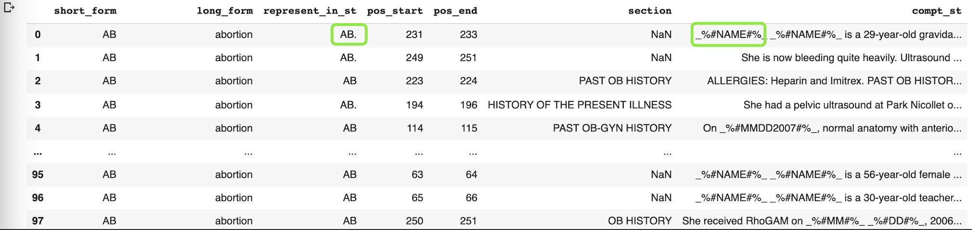
Dataset Overview
37500 Entries
75 Short forms （abbreviations and acronyms）
351 Long forms (possible senses)
500 Entries under each short_form’s category

Slide 9
Text Preprocessing
Text
Preprocessing
Feature
Transformation
Modeling
Scoring Metrics
Validation
Convert all keywords in the sentence in a proper form
Raw Doctor Notes
We thought that tracheomalacia might be playing a role in her symptoms because of the history of the tracheoesophageal fistula. V.B.G. at the time of admission was pH 7.37, PCO2 43 on 2 liters per minute of O2. CBC showed a white count of 15,200 and hemoglobin 13.5 with a platelet count of 804,000.
We thought that tracheomalacia might be playing a role in her symptoms because of the history of the tracheoesophageal fistula. VBG at the time of admission was pH 7.37, PCO2 43 on 2 liters per minute of O2. CBC showed a white count of 15,200 and hemoglobin 13.5 with a platelet count of 804,000.
Notes:
Properly cleaned data is essential to do a good text analysis.
Regex:
1. replace unnecessary keywords and number
2. Clean de-identify infomation

Slide 10
Text Preprocessing
Remove numbers
Convert all keywords in the sentence in a proper form
Raw Doctor Notes
Regex based text cleaning & lower case
Remove de-identify information symbol (e.g. name, email, mmdd, address, etc)
Remove special characters
We thought that tracheomalacia might be playing a role in her symptoms because of the history of the tracheoesophageal fistula. VBG at the time of admission was pH 7.37, PCO2 43 on 2 liters per minute of O2. CBC showed a white count of 15,200 and hemoglobin 13.5 with a platelet count of 804,000.
we thought that tracheomalacia might be playing a role in her symptoms because of the history of the tracheoesophageal fistula. vbg at the time of admission was ph 7.37, pco2 43 on 2 liters per minute of o2. cbc showed a white count of 15,200 and hemoglobin 13.5 with a platelet count of 804,000.
Notes:
Properly cleaned data is essential to do a good text analysis.
Regex:
1. replace unnecessary keywords and number
2. Clean de-identify infomation

Slide 11
Text Preprocessing
Convert all keywords in the sentence in a proper form
Raw Doctor Notes
Regex based text cleaning & lower case
Use nltk library to remove stop words
we thought that tracheomalacia might be playing a role in her symptoms because of the history of the tracheoesophageal fistula. vbg at the time of admission was ph 7.37, pco2 43 on 2 liters per minute of o2. cbc showed a white count of 15,200 and hemoglobin 13.5 with a platelet count of 804,000.
we thought that tracheomalacia might be playing a role in her symptoms because of the history of the tracheoesophageal fistula. vbg at the time of admission was ph 7.37, pco2 43 on 2 liters per minute of o2. cbc showed a white count of 15,200 and hemoglobin 13.5 with a platelet count of 804,000.
Notes:
Properly cleaned data is essential to do a good text analysis.
Regex:
1. replace unnecessary keywords and number
2. Clean de-identify infomation

Slide 12
Text Preprocessing
Convert all keywords in the sentence in a proper form
Raw Doctor Notes
Regex based text cleaning & lower case
Use nltk library to remove stop words
Clean Doctor Notes
We thought that tracheomalacia might be playing a role in her symptoms because of the history of the tracheoesophageal fistula. V.B.G. at the time of admission was pH 7.37, PCO2 43 on 2 liters per minute of O2. CBC showed a white count of 15,200 and hemoglobin 13.5 with a platelet count of 804,000.
we thought tracheomalacia might playing role symptoms history tracheoesophageal fistula vbg time admission ph pco2 liters per minute o2 cbc showed white count hemoglobin platelet count
Notes:
Properly cleaned data is essential to do a good text analysis.
Regex:
1. replace unnecessary keywords and number
2. Clean de-identify infomation

Slide 13
03
Model Development

Slide 14
Model Pipeline
Feature
Engineering
Modeling
Scoring Metrics
Validation
Text
Preprocessing
11-words windows
Section
TF-IDF
Naive Bayes
Support Vector Machine
Random Forest
Distill BERT
F1-score
Accuracy
k-fold Validation

Slide 15
Feature Transformation and Engineering
Text
Preprocessing
Feature
Engineering
Modeling
Scoring Metrics
Validation
Clean Doctor Notes
Feature Union
10 words around keywords
(Textual Inputs)
TF-IDF Vectorizer
Feature Transformation
Conventional Models
Section
(Category Input) String
Categorical Feature

Slide 16
Feature Engineering
Section (Categorical Data)
Textual Data
missing value
--> Use the most frequent
section value in each
short_form category
Label Reformat
--> Transform text of each
category to numerical
label
Use 10 words around the keyword as a new column
--> avoid multiple keys in a cell.
Set up unigrams, bigrams, and trigrams

Slide 17
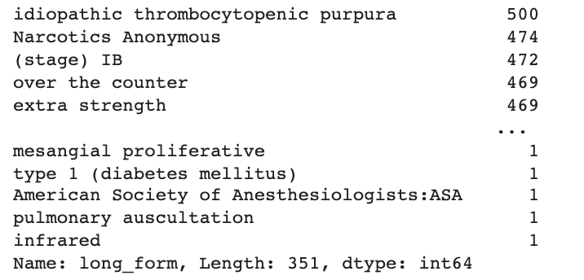
Feature Engineering
The long form column is our target variables, and it has 351 different categories. The data is unbalanced, with some categories only have 1 record.
--> filter out categories that have less than 125 records
(20% of the maximum number records a category has)
--> There are 32,566 records with 102 classes left
Apply TF-IDF vectorizer and combine it with the categorical variance section

Slide 18
Baseline Model - Naive Bayes
Text
Preprocessing
Feature
Transformation
Modeling
Scoring Metrics
Validation
Result
Clean Doctor Notes
2000 most frequent words
Result
Weighted avg F1-Score: 0.94
Accuracy: 0.94
Run time: 50 mins for training and validation
Runout of memory easily for large corpora
NLTK
NaiveBayesClassifer
short_form
Notes:
N-gram
https://stackoverflow.com/questions/64568775/tf-idf-vectorizer-to-extract-ngrams

Slide 19
Model 1 - Random Forest
Unigrams
Bigrams
Feature Union
TF-IDF Vectorizer
Unigrams
Bigrams
Trigrams
Random Forest Classifier
GridSearchCV
K = 5
Categorical Feature

Slide 20
Model 1 - Random Forest Parameters & Result
Unigrams, Bigrams
Unigrams, Bigrams, Trigrams
Parameters
Number of estimators: 56
Minimum samples leaf: 2
Minimum samples split: 3
Result
Weighted avg F1-Score: 0.95
Accuracy: 0.95
Run time: 7 mins
Parameters
Number of estimators: 100
Minimum samples leaf: 2
Minimum samples split: 10
Result
Weighted avg F1-Score: 0.95
Accuracy: 0.95
Run time: 8 mins
Notes:
https://towardsdatascience.com/multi-class-text-classification-with-sklearn-and-nltk-in-python-a-software-engineering-use-case-779d4a28ba5
https://towardsdatascience.com/how-to-combine-textual-and-numerical-features-for-machine-learning-in-python-dc1526ca94d9

Slide 21
Model 1 - Random Forest Parameters & Result
Unigrams, Bigrams + Section
Unigrams, Bigrams, Trigrams + Section
Parameters
Number of estimators: 78
Minimum samples leaf: 2
Minimum samples split: 3
Result
Weighted avg F1-Score: 0.95
Accuracy: 0.95
Run time: 7 mins
Parameters
Number of estimators: 78
Minimum samples leaf: 2
Minimum samples split: 3
Result
Weighted avg F1-Score: 0.94
Accuracy: 0.94
Run time: 8 mins
Notes:
https://towardsdatascience.com/multi-class-text-classification-with-sklearn-and-nltk-in-python-a-software-engineering-use-case-779d4a28ba5
https://towardsdatascience.com/how-to-combine-textual-and-numerical-features-for-machine-learning-in-python-dc1526ca94d9

Slide 22
Model 2 - Support Vector Machine
Text
Preprocessing
Feature
Transformation
Modeling
Scoring Metrics
Validation
Feature Union
(1, 2, 3) - grams
TF-IDF Vectorizer
SVM
For trigrams
Categorical Feature

Slide 23
Model 2 - Support Vector Machine Result
Unigrams, Bigrams
Unigrams, Bigrams, Trigrams
Result
Weighted avg F1-Score: 0.96
Accuracy: 0.96
Run time: 10 mins
Result
Weighted avg F1-Score: 0.96
Accuracy: 0.96
Run time: 11 mins
Notes:
https://towardsdatascience.com/multi-class-text-classification-with-sklearn-and-nltk-in-python-a-software-engineering-use-case-779d4a28ba5
https://towardsdatascience.com/how-to-combine-textual-and-numerical-features-for-machine-learning-in-python-dc1526ca94d9

Slide 24
Model 2 - Support Vector Machine Result
Unigrams, Bigrams + Section
Unigrams, Bigrams, Trigrams + Section
Result
Weighted avg F1-Score: 0.94
Accuracy: 0.94
Run time: 9 mins
Result
Weighted avg F1-Score: 0.93
Accuracy: 0.93
Run time: 10 mins
Notes:
https://towardsdatascience.com/multi-class-text-classification-with-sklearn-and-nltk-in-python-a-software-engineering-use-case-779d4a28ba5
https://towardsdatascience.com/how-to-combine-textual-and-numerical-features-for-machine-learning-in-python-dc1526ca94d9

Slide 25
Model 3 - Distill BERT
Text
Preprocessing
Feature
Transformation
Modeling
Scoring Metrics
Validation
Why BERT(Bidirectional Encoder Representations From Transformers)?
pre-trained on a lot of data
BERT-base (trained on BooksCorpus: ~800 million words)
BERT-large (trained on English Wikipedia: ~ 2,500 million words)
accounts for a word’s context
word-embedding method: BERT returns different vectors for the same word depending on the words around it
open-source
Why distill BERT?
reduce the size of a BERT model by 40% (40% less parameters than BERT-base)
distill(teacher-student learning): compress technique
a small model is trained to reproduce the behavior of a larger model
retain 95% of its language understanding capabilities
60% faster than BERT-base

Slide 26
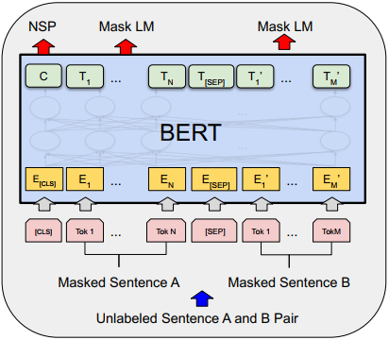
Apply our text to distill BERT model
Text
Preprocessing
Feature
Transformation
Modeling
Scoring Metrics
Validation
Input:
Original Complete Sentence
Use Ktrain to load and preprocess text to the format that 'distilbert-base-uncased’ model need

Slide 27
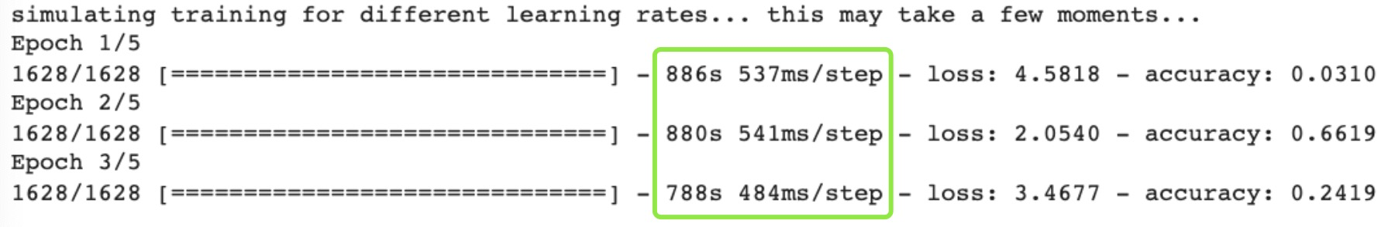
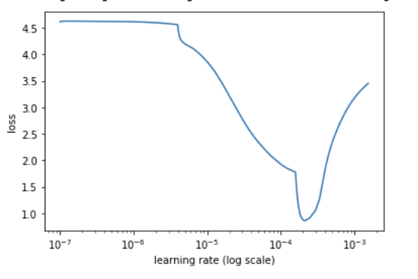
Distill BERT with batch_size =16
With batch_size=16
Need around 45 mins using Colab Pro GPU to find the best learning rate 10^-4

Slide 28
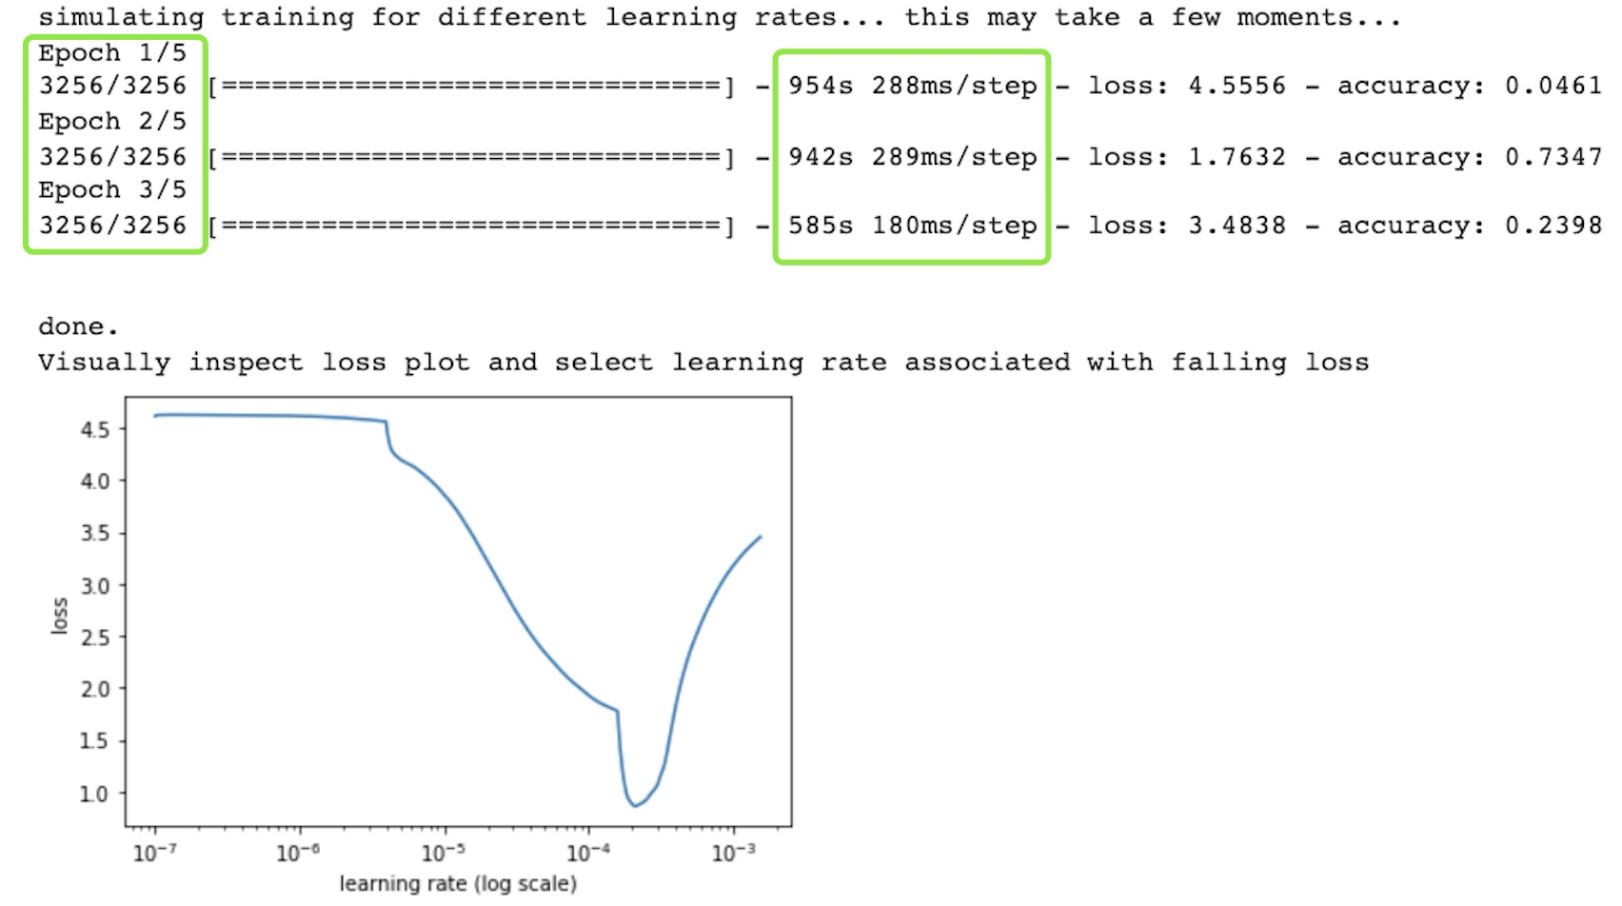
Distill BERT with batch_size =8
With batch_size=8
run time increase from 45 mins to 48 mins, best learning rate is still 10^-4

Slide 29
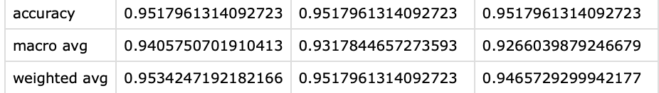
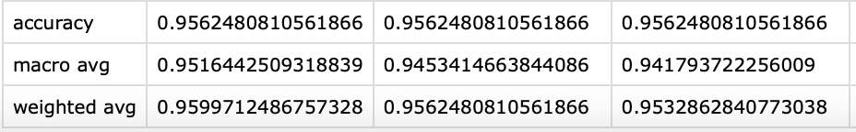
Hyperparameter choosing for distill BERT
Batch_size=16
Run time: 45mins
Batch_size=8
Run time:
47 mins
Not a big difference, both performs pretty well with F1 score= 0.95 !

Slide 30
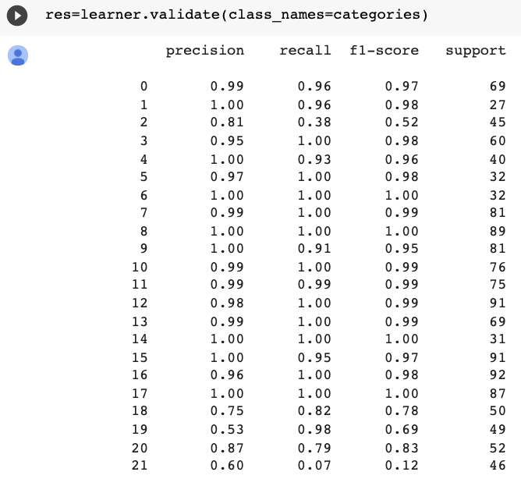
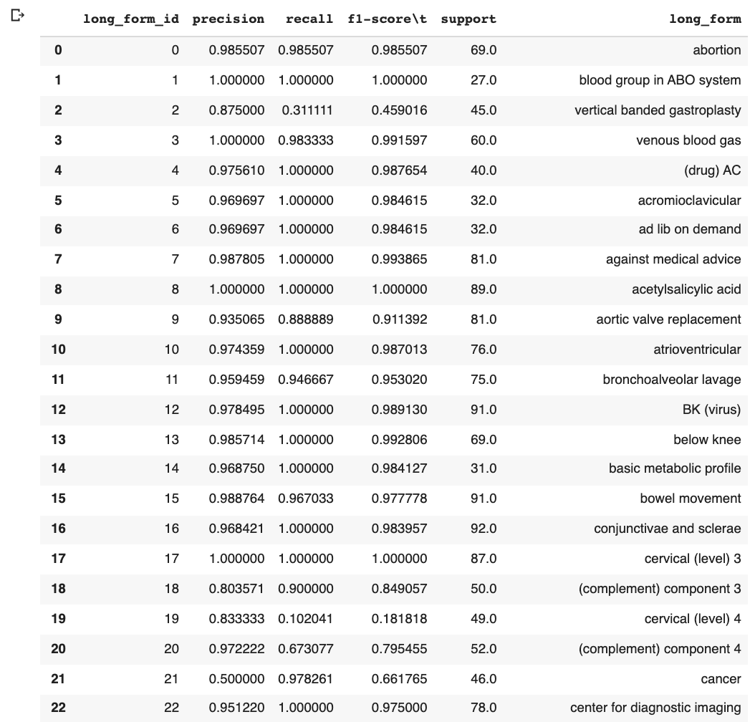
Distill BERT result
Use self-defined dictionary:
Categories to transfer back from long_form_id to long_form

Slide 31
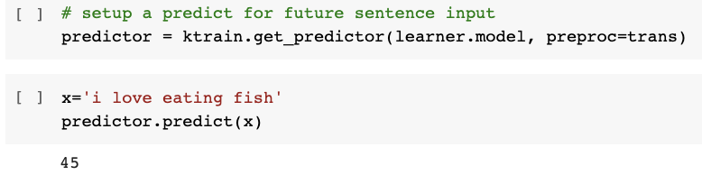
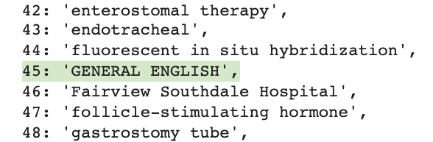
Simple Test with distill BERT:
Categories:
Decoder 45 ==> GENERAL ENGLISH
FISH is one of the short form, and can be interpreted into ['fluorescent in situ hybridization', 'GENERAL ENGLISH']in doctor’s notes

Slide 32
5-fold Cross-Validation Result (average)
Text
Preprocessing
Feature
Transformation
Modeling
Scoring Metrics
Validation
 | Fit_time (s) | Score_ time (s) | Train_ accuracy | Train_f1_ weighted | Test_ accuracy | Test_f1_ weighted
RF (1, 2)-grams | 6.742 | 0.555 | 0.963 | 0.961 | 0.945 | 0.941
RF (1, 2, 3)-grams | 11.985 | 0.897 | 0.963 | 0.961 | 0.944 | 0.941
RF (1, 2)-grams + section | 9.049 | 0.711 | 0.965 | 0.963 | 0.946 | 0.943
RF (1, 2, 3)-grams + section | 10.014 | 0.795 | 0.963 | 0.961 | 0.944 | 0.940
SVM (1, 2)-grams | 836.192 | 37.830 | 0.997 | 0.997 | 0.962 | 0.962
SVM (1, 2, 3)-grams | 945.551 | 41.342 | 0.997 | 0.997 | 0.961 | 0.961
SVM (1, 2)-grams + section | 751.664 | 38.674 | 0.989 | 0.989 | 0.942 | 0.942
SVM (1, 2, 3)-grams + section | 833.816 | 40.787 | 0.988 | 0.988 | 0.940 | 0.939

Slide 33
Performance on Test Set
Text
Preprocessing
Feature
Transformation
Modeling
Scoring Metrics
Validation
Model | Weighted avg F1 Score | Run Time
Random Forest (1, 2)-grams + section | 0.94 | 9 seconds
Distill BERT | 0.95 | 15 mins

Slide 34
04
Conclusions & Future Work

Slide 35
Conclusions
Based on the combination of F1 score and run time, we recommend Random Forest with variables (1, 2)-grams and section for abbreviation identification
If there are additional tests need to complete, distill BERT could also be considered, for instance: identify synonymous words and their relationship importance
Size of the dataset highly positive related to the accuracy of models(10 times larger dataset: accuracy increased from 0.8 to 0.9)
Feature Work:
Build models for categories that have less than 125 records.
Train model using Bio BERT, a pre-trained biomedical language representation model for biomedical text mining
Create a plug-in feature.
Patient could use to translate doctors’ electronic health record

Slide 36
THANKS
Do you have any questions?

Slide 37
Packages and Tools for Modeling
Models | Package
TF-IDF | from sklearn.feature_extraction.text import TfidfVectorizer
NLTK NaiveBayesClassifier | import nltk
Random Forest | from sklearn.ensemble import RandomForestClassifier
SVM | from sklearn.svm import SVC
Distill BERT | model_name='distilbert-base-uncased' trans=text.Transformer(model_name, maxlen=512, class_names=categories)
Ktrain | learner=ktrain.get_learner(model,train_data=train_data,val_data=test_data, batch_size=8)
Support TooL: Colab Pro GPU

Slide 38
Reference
Data source: https://conservancy.umn.edu/handle/11299/137703
https://towardsdatascience.com/multi-class-text-classification-with-sklearn-and-nltk-in-python-a-software-engineering-use-case-779d4a28ba5
https://towardsdatascience.com/ktrain-a-lightweight-wrapper-for-keras-to-help-train-neural-networks-82851ba889c#:~:text=ktrain%20is%20a%20library%20to,deep%20learning%20software%20framework%2C%20Keras.&text=Inspired%20by%20the%20fastai%20library,using%20a%20learning%20rate%20finder
https://arxiv.org/abs/1910.01108
https://huggingface.co/distilbert-base-uncased
https://www.youtube.com/watch?v=s3LBdmZb00g
https://towardsdatascience.com/bert-why-its-been-revolutionizing-nlp-5d1bcae76a13
https://www.kaggle.com/ynouri/random-forest-k-fold-cross-validation

